Slide 1
APPLICATION LAYER
Standard Application Layer Protocols

Slide 2
DNS

Slide 3
DNS
Stands for Domain Name System
Devices on the network has IP addresses
But Human always prefers names instead of numeric addresses
DNS maps the human readable addresses to corresponding IP addressees
DNS uses UDP

Slide 4
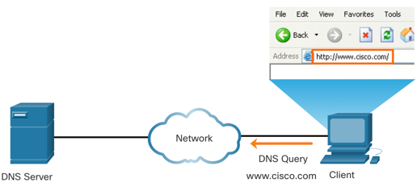
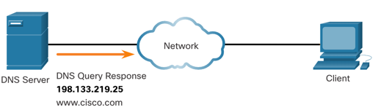
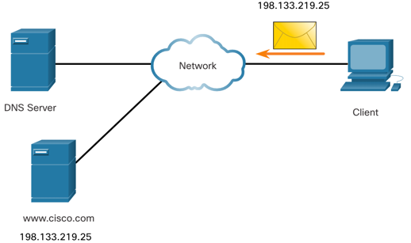
DNS
Domain names were created to convert the numeric IP addresses into a simple, recognizable name.
Fully-qualified domain names (FQDNs), such as http://www.cisco.com, are much easier for people to remember than 198.133.219.25.
The DNS protocol defines an automated service that matches resource names with the required numeric network address. It includes the format for queries, responses, and data.
Notes:
15 – Application Layer
15.4 – IP Addressing Services
15.4.1 – Domain Name Service

Slide 5
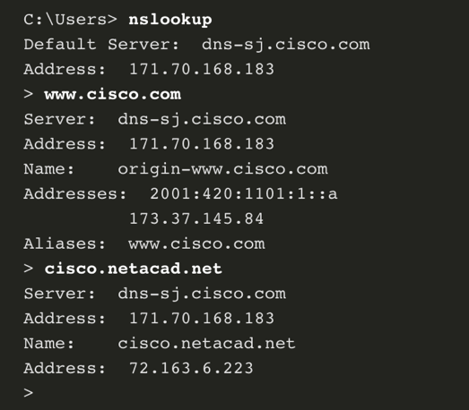
The nslookup Command
Nslookup is a computer operating system utility that allows a user to manually query the DNS servers configured on the device to resolve a given host name.
This utility can also be used to troubleshoot name resolution issues and to verify the current status of the name servers.
When the nslookup command is issued, the default DNS server configured for your host is displayed.
The name of a host or domain can be entered at the nslookup prompt.
Notes:
15 – Application Layer
15.4 – IP Addressing Services
15.4.4 – The nslookup Command
15.4.5 – Syntax Checker – The nslookup Command

Slide 6
DNS Process Overview
User machine runs client side of the DNS application
The browser (or any other program that uses URL) extracts the hostname to the client side of the DNS application
The DNS client sends a query containing the hostname to a DNS application
The DNS client eventually receives a reply, which includes the ip address of the hostname

Slide 7
Name Space
Maps each address to a unique name
Organized in two ways
Flat Name Space
Hierarchical Name Space

Slide 8

Flat Name Space
Names are interpreted as a single, whole label
No internal structure
No clear relationship between any two names
Explorer
Eternity
Standard
Neutral

Slide 9
Hierarchical Name Space
Logical grouping is possible based on the names
cse.x
cse.y
eee.x
eee.y

Slide 10
Domain Name Space
Names are defined in an inverted-tree structure with the root at the top
Tree can have at most 128 levels
arpa
com
org
ad
zw

Slide 11
Labels & Domain Name
Label
Each node has a label of maximum 63 characters
Root is labeled with null string
Children of a node must have different labels for uniqueness
Domain Name
Each node of a tree has a domain name
A full domain name is a sequence of labels separated by dots(.)
Read from node up to the root.

Slide 12
Label & Domain Name (Explained)
bd
bd
ac
ac.bd
buet
buet.ac.bd
teacher
teacher.buet.ac.bd

Slide 13
Fully Qualified Domain Name
An FQDN is a domain name that contains the full name of a host
Starts from a node and read up to the root
It uniquely defines the host machine irrespective of the location of client
teacher.buet.ac.bd

Slide 14
Partially Qualified Domain Name
PQDN starts from a node but does not reach the root
Used when the name to be resolved belongs to the same site as the client
Resolver can supply the suffix to create an FQDN
teacher
User is at buet.ac.bd

Slide 15
Domain
Subtree of the DNS
The name of the domain is the Domain Name of the node at the top of the subtree
Domain is divided in subdomains
arpa
com
org

Slide 16
DNS Information storing
In a single server
Inefficient
Unreliable
Multiple and Distributed
Efficient
Reliable
But Processing Requires structure and protocols

Slide 17
Inefficiency of Single Server
Single point of failure
Traffic Volume high. All requests have to be handled by a single DNS server
A single DNS server cannot be close to all querying clients
It would be updated frequently for every new host .

Slide 18
Hierarchy of Name Server
Each server known as DNS server
Each server is responsible(authoritative) for a domain
Three classes of Server
Root DNS Server
Top-level Domain (TLD) Server
Authoritative DNS Server

Slide 19
Types of DNS Server
Root Server
org
ad
TLD
arpa
com
zw
cisco.com

Slide 20
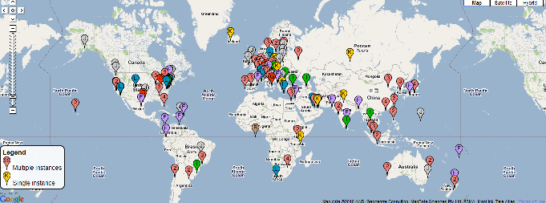
Root DNS Server
Root DNS Server
Number of Root servers distributed throughout the world
Some servers are in fact cluster

Slide 21
TLD Server & Authoritative DNS Server
TLD Server
These servers are responsible for Generic Top-level Domains such as com, org, net, edu and gov and all of the Country Top-level Domains such as uk, fr, ca, bd
Authoritative DNS Server
Every organization with publicly accessible host must provide publicly accessible DNS records that map names of those host to IP Addresses
An organization authoritative DNS houses these DNS records

Slide 22
Local DNS Server
Does not strictly belong to the hierarchy of servers
Each ISP has a local DNS server
When a host connects to the ISP, the ISP provides IP addresses one or more of its local DNS servers
When a host makes a DNS query, the query is sent to the local DNS server which acts as a proxy, forwarding the query into the DNS server hierarchy

Slide 23
Zone
Refers to a certain portion or administrative space within the global DNS
All DNS zones form the DNS namespace
Depending on the administrative rights delegated to a certain entity, DNS zones may consist of only one domain, or of many domains and sub-domains.
Further authority over a sub-space could be delegated to other servers, if necessary.
Zone File keeps all information for every node under the domain

Slide 24
Zone Explained
buet.ac.bd
cse.buet.ac.bd

Slide 25
Authoritative DNS Server Types
Primary DNS Server
Stores a file about the zone for which it is an authority
Responsible for creating, maintaining and updating Zone file
Stores zone file in a local disk
Secondary DNS Server
Transfers the complete information about a zone from another server (primary or secondary) and stores the file in the local disk

Slide 26
Primary and Secondary Servers
Both are authoritative for the zone that they serve
The method of downloading information by secondary from primary is known as Zone Transfer
Utility
Create Redundancy to mitigate the failure

Slide 27
Resolver
Host that needs to map an address to a name or a name to an address calls a DNS client called a Resolver
The resolver accesses the closest DNS server with a mapping request.
If the server has the information, it satisfies the resolver, otherwise, it either refers the resolver to other servers or other servers to provide information
It also checks the occurrence of any error

Slide 28
Recursive Resolution
Resolver accepts the server to supply the final answer
If the server is the authority of the DNS, it supplies the answer
If the server is not authority, it send the request to other server (usually parent) and waits for the response.
If the parent is authority, it responds, otherwise, it sends request to another one
When the query is resolved, then the response travel backs to the client

Slide 29
Recursive Resolution Explained
Root Server
3
2
7
6
Local DNS Server
dns.yale.edu
TLD DNS Server
com
8
5
4
1
Requesting Host
cs.yale.edu
Authoritative DNS Server
dns.google.com

Slide 30
Iterative Resolution
The client requests the local DNS.
Local DNS then request another DNS Server
If the server is an authority for the name, it sends the answer
If the server is not an authority, it returns the ip addresses of the server which it thinks can resolve the query.
The local DNS then repeats the query to the second server and so on
Finally Client receives the resolution from Local DNS server

Slide 31
Iterative Resolution Explained
Root Server
Local DNS Server
dns.yale.edu
2
3
4
TLD DNS Server
com
5
8
6
1
7
Requesting Host
cs.yale.edu
Authoritative DNS Server
dns.google.com

Slide 32
Caching
Reduction in DNS lookup can be reduced at a greater scale if the mapping is stored locally
When a server asks for a mapping from another server and receives response, it stores the information in its cache memory before sending it to client to satisfy other clients afterwards without further query
The response coming from the cache is marked as Unauthoritative
TTL is used to keep track of older records. The records are purged periodically.

Slide 33
DNS Records
DNS servers store information in Resource Records
Some Resource Records provide hostname-to-ip mapping
Resource Record is a four-tuple
(Name, Value, Type, TTL)
TTL
Determines when a resource record should be removed from the cache
The meaning of Name and Value depend on Type

Slide 34
Type Explained
Type=A
Name- Hostname
Value – IP Address
Provides standard hostname to IP Address Mapping
(sites.google.com, 142.23.23.1, A, 200)
Type=NS
Name – Domain
Value – Hostname of an authoritative DNS server that may know the information about the domain
Provides routing the DNS query
(sites.google.com, dns.google.com, NS, 125)

Slide 35
Type Explained
Type = CNAME
Name – Alias Domain Name
Value – Main Domain Name
Specifies that the domain name is an alias of another
This helps when running multiple services (like an FTP and a web server; each running on different ports) from a single IP address. Each service can then have its own entry in DNS.
(www.cs.mit.edu, star.cs.mit.edu, CNAME, 120)

Slide 36
Type Explained
Type=MX
Name - Hostname
Value – The address of the Mail Server
A company can use the same aliased name for all its mail server and for one of its other server
(buet.ac.bd, mail.buet.ac.bd, MX, 125)

Slide 37
A and NS Record Explained
If a DNS server is authoritative for a particular domain, it contains a Type A record
If a server is not authoritative for a hostname, then it contains a type NS record for the domain that includes the hostname; it will also contain a Type A record that provides the ip address of the DNS server in the value field of the NS record
TLD is not authoritative for cs.mit.edu
(mit.edu, dns.mit.edu, NS, 123)
(dns.mit.edu, 123.22.32.21, A, 134)

Slide 38
DHCP

Slide 39
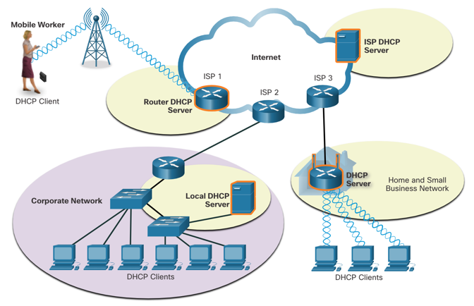
Dynamic Host Configuration Protocol
DHCP service automates the assignment of IPv4 addresses, subnet masks, gateways, and other IPv4 networking parameters.
DHCP is considered dynamic addressing compared to static addressing. Static addressing is manually entering IP address information.
Notes:
15 – Application Layer
15.4 – IP Addressing Services
15.4.6 – Dynamic Host Configuration Protocol

Slide 40
DHCP
When a host connects to the network, the DHCP server is contacted, and an address is requested. The DHCP server chooses an address from a configured range of addresses called a pool and assigns (leases) it to the host.
Many networks use both DHCP and static addressing. DHCP is used for general purpose hosts, such as end user devices. Static addressing is used for network devices, such as gateway routers, switches, servers, and printers.

Slide 41
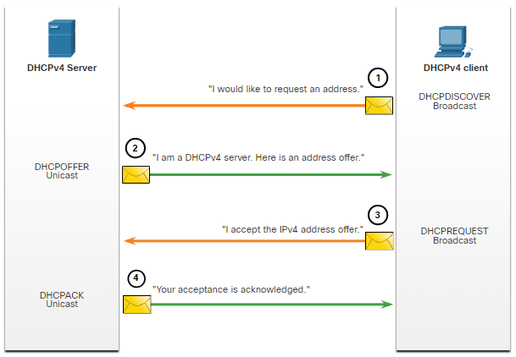
Steps to Obtain a Lease
When the client boots (or otherwise wants to join a network), it begins a four-step process to obtain a lease:
DHCP Discover (DHCPDISCOVER)
DHCP Offer (DHCPOFFER)
DHCP Request (DHCPREQUEST)
DHCP Acknowledgment (DHCPACK)
Notes:
7 – DHCPv4
7.1 – DHCPv4 Concepts
7.1.3 – Steps to Obtain a Lease

Slide 42
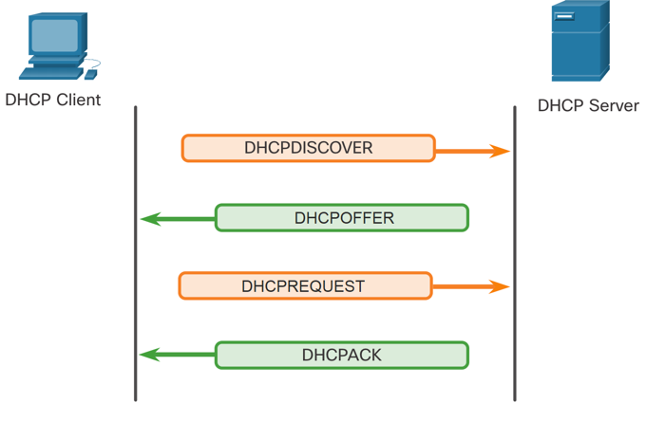
IP Addressing Services DHCP Operation
The DHCP Process:
When an IPv4, DHCP-configured device boots up or connects to the network, the client broadcasts a DHCP discover (DHCPDISCOVER) message to identify any available DHCP servers on the network.
A DHCP server replies with a DHCP offer (DHCPOFFER) message, which offers a lease to the client. (If a client receives more than one offer due to multiple DHCP servers on the network, it must choose one.)
The client sends a DHCP request (DHCPREQUEST) message that identifies the explicit server and lease offer that the client is accepting.
The server then returns a DHCP acknowledgment (DHCPACK) message that acknowledges to the client that the lease has been finalized.
If the offer is no longer valid, then the selected server responds with a DHCP negative acknowledgment (DHCPNAK) message and the process must begin with a new DHCPDISCOVER message.
Notes:
15 – Application Layer
15.4 – IP Addressing Services
15.4.7 – DHCP Operation

Slide 43
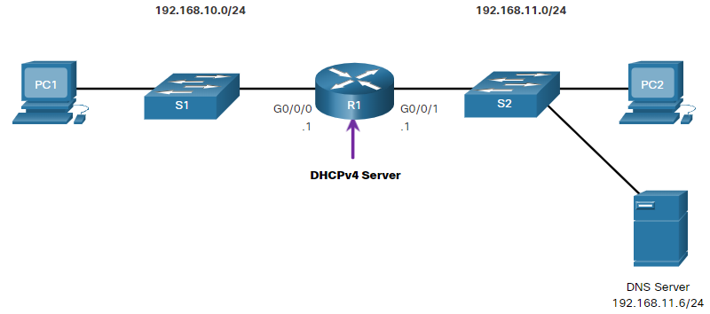
Configuring a Router as DHCPv4 Server
Now you have a basic understanding of how DHCPv4 works and how it can make your job a bit easier. A Cisco router running Cisco IOS software can be configured to act as a DHCPv4 server. The Cisco IOS DHCPv4 server assigns and manages IPv4 addresses from specified address pools within the router to DHCPv4 clients.
Notes:
7 – DHCPv4
7.2 – Configure a Cisco IOS DHCPv4 Server
7.2.1 – Cisco IOS DHCPv4 Server

Slide 44
Steps to Configure a Cisco IOS DHCPv4 Server (Cont.)
Task | IOS Command
Define the address pool. | network network-number [mask | / prefix-length]
Define the default router or gateway. | default-router address [ address2….address8]
Define a DNS server. | dns-server address [ address2…address8]
Define the domain name. | domain-name domain
Define the duration of the DHCP lease. | lease {days [hours [ minutes]] | infinite}
Define the NetBIOS WINS server. | netbios-name-server address [ address2…address8]
Notes:
7 – DHCPv4
7.2 – Configure a Cisco IOS DHCPv4 Server
7.2.2 – Steps to Configure a Cisco IOS DHCPv4 Server (Cont.)

Slide 45
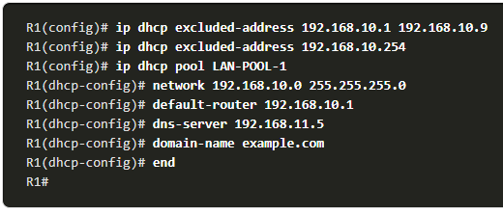
Configuration Example
Notes:
7 – DHCPv4
7.2 – Configure a Cisco IOS DHCPv4 Server
7.2.3 – Configuration Example

Slide 46
Configure a Cisco IOS DHCPv4 Server DHCPv4 Verification
Use the commands in the table to verify that the Cisco IOS DHCPv4 server is operational.
Command | Description
show running-config | section dhcp | Displays the DHCPv4 commands configured on the router.
show ip dhcp binding | Displays a list of all IPv4 address to MAC address bindings provided by the DHCPv4 service.
show ip dhcp server statistics | Displays count information regarding the number of DHCPv4 messages that have been sent and received
Notes:
7 – DHCPv4
7.2 – Configure a Cisco IOS DHCPv4 Server
7.2.4 – DHCPv4 Verification

Slide 47
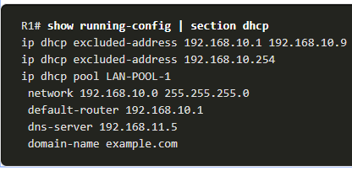
Configure a Cisco IOS DHCPv4 Server Verify DHCPv4 is Operational
Verify the DHCPv4 Configuration: As shown in the example, the show running-config | section dhcp command output displays the DHCPv4 commands configured on R1. The | section parameter displays only the commands associated with DHCPv4 configuration.
Notes:
7 – DHCPv4
7.2 – Configure a Cisco IOS DHCPv4 Server
7.2.5 – Verify DHCPv4 is Operational

Slide 48
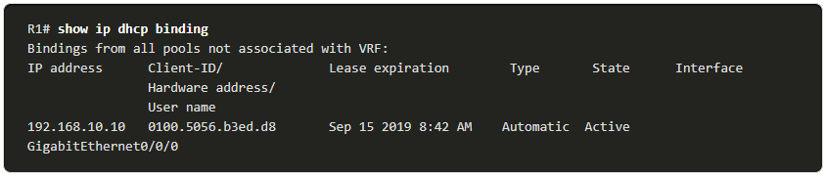
Configure a Cisco IOS DHCPv4 Server Verify DHCPv4 is Operational (Cont.)
Verify DHCPv4 Bindings: As shown in the example, the operation of DHCPv4 can be verified using the show ip dhcp binding command. This command displays a list of all IPv4 address to MAC address bindings that have been provided by the DHCPv4 service.
Notes:
7 – DHCPv4
7.2 – Configure a Cisco IOS DHCPv4 Server
7.2.5 – Verify DHCPv4 is Operational (Cont.)

Slide 49
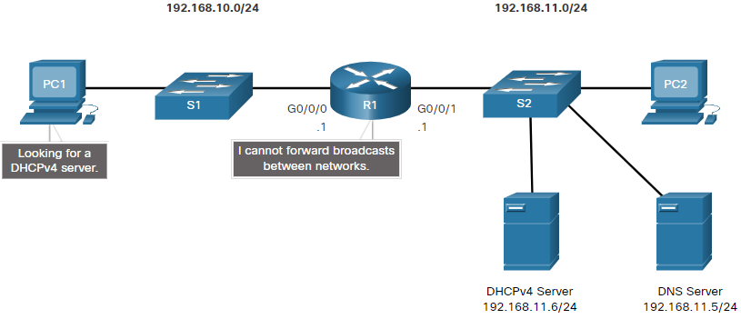
Configure a Cisco IOS DHCPv4 Server DHCPv4 Relay
In a complex hierarchical network, enterprise servers are usually located centrally. These servers may provide DHCP, DNS, TFTP, and FTP services for the network. Network clients are not typically on the same subnet as those servers. In order to locate the servers and receive services, clients often use broadcast messages.
In the figure, PC1 is attempting to acquire an IPv4 address from a DHCPv4 server using a broadcast message. In this scenario, R1 is not configured as a DHCPv4 server and does not forward the broadcast. Because the DHCPv4 server is located on a different network, PC1 cannot receive an IP address using DHCP. R1 must be configured to relay DHCPv4 messages to the DHCPv4 server.
Notes:
7 – DHCPv4
7.2 – Configure a Cisco IOS DHCPv4 Server
7.2.8 – DHCPv4 Relay

Slide 50
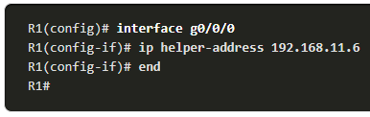
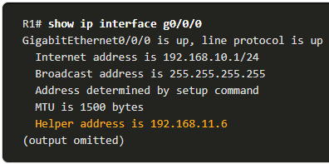
DHCPv4 Relay Configuration
Configure R1 with the ip helper-address address interface configuration command. This will cause R1 to relay DHCPv4 broadcasts to the DHCPv4 server. As shown in the example, the interface on R1 receiving the broadcast from PC1 is configured to relay DHCPv4 address to the DHCPv4 server at 192.168.11.6.
When R1 has been configured as a DHCPv4 relay agent, it accepts broadcast requests for the DHCPv4 service and then forwards those requests as a unicast to the IPv4 address 192.168.11.6. The network administrator can use the show ip interface command to verify the configuration.
Notes:
7 – DHCPv4
7.2 – Configure a Cisco IOS DHCPv4 Server
7.2.8 – DHCPv4 Relay (Cont.)

Slide 51
HTTP

Slide 52
HTTP
Stands for Hyper Text Transfer Protocol
Uses the services of TCP on well-known port 80
HTTP messages are read and interpreted by the HTTP server and HTTP client(browser)
HTTP is a stateless protocol as HTTP server does not store any information for the clients
Uses TCP

Slide 53
URL
Abbreviated Form of
Uniform Resource Locator
Components
Protocol
Host
Port (Optional)
Path
File Name

Slide 54
URL (Explained)
Protocol
The client/server program used to retrieve the document
Host
The computer on which the information is located
Port
Optionally contains the port number of the server
Path
The pathname of the file where the information is located
Slashes separates the directories

Slide 55
URL (Explained)
http://www.buet.ac.bd/cse/index.html
Host
File Name
Path
Protocol

Slide 56
Hypertext
Obviously, Hypertext file is a Collection of Text, like Document File.
What is Extra?
Certain words within the text are marked as links to other areas of the current document or to other documents

Slide 57

HTTP Communication
Web Server
Request
Response
Request
Response
Client
Client

Slide 58
Non-persistent Connection
One TCP connection is made for each request/response
Strategy
The client opens a TCP connection and sends a request
The server sends the response and closes the connection
The client reads the data until it encounters and end-of-file marker; it then closes the connection
HTTP prior to version 1.1 specified non-persistent connection
Disadvantages
High overhead for server to maintain separate connections for all separate requests between a specific host.
Slow start

Slide 59
Persistent Connection
Server leaves the connection open for more requests after sending a response
The server can close the connection at the request of a client or if a time-out has been reached
HTTP version 1.1 specifies persistent connection as default

Slide 60
HTTP Message Format
HTTP Request
HTTP Response
Request Line
Response Line
Headers
Headers
A Blank Line
A Blank Line
Body
(present only in some messages)
Body
(present only in some messages)

Slide 61
Request Line
Request Type
URL
HTTP Version
Request Type- Identifies the request type
URL – The URL of the requested object
Method | Action
GET | Requests a document from the server
HEAD | Requests information about a document in the server, but not the document
POST | Sends some information from the client to server
PUT | Sends a document from the server to client
TRACE | Echoes the incoming request
CONNECT | Reserved
OPTION | Inquires about the available options

Slide 62
Status Line
HTTP Version
Status Code
Status Phrase
Code | Phrase | Description
100 | Continue | The initial part of the request is received, and the client may continue its request
200 | OK | The request is successful
202 | Accepted | The request is accepted, but it is not immediately acted upon
204 | No content | There is no content in the body
400 | Bad Request | There is a syntax error in the request
401 | Unauthorized | The request lacks authorization
404 | Not found | The document is not found
500 | Internal Server Error | There is error, such a crash, at the server side

Slide 63
HTTP Headers
Header Name:
Value
Three types of Headers
General Header
Gives general information about the message
Can be present in both response and request
Request Header
Present only in the request message
Specifies the client configuration and client’s preferred document format
Response Header
Present only in the response message
Provides server configuration and special information about the request

Slide 64
Cookies
HTTP server is stateless
But identification is useful restricting access, personalized content
Components
Cookie header line in HTTP response message
Cookie header line in HTTP request message
Cookie file kept on user’s host and managed by user’s browser
Back-end database at Web site

Slide 65
Cookies Explained
usual http request message
Server
Creates
id 1672
for user
usual http response
set cookie: 1672
amazon:
1672
usual http request message
cookie: 1672
DB
amazon:
1672
Cookie
Specific
Action
usual http response

Slide 66
Advantages & Disadvantages
Advantages
Authorization, shopping carts recommendation, user session state
Disadvantages
Websites learns a lot about user

Slide 67
Proxy Server
User sets browser: all Web accesses via proxy
Browser sends all HTTP requests to proxy
If object in proxy, proxy returns the object
If the object is not there, proxy requests object from origin server, returns object to client, stores
Reduces
Delay
Network Traffic

Slide 68
Proxy Server Explained
Request
1
4
Request
2
Client
Response
5
3
Response
Request
Proxy
Server
Origin
Server
Response
6
Client

Slide 69
Electronic Mail

Slide 70
Architecture
System comprises of
User Agents
Mail Servers
User Agent
User Agent
Mail Transfer
Mail
Server
Mail
Server
User Agent
User Agent

Slide 71
User Agent
User Agent
Mail Client
Purpose - Composing, editing, reading mail messages
Eudora, Outlook
Mail Server
Mailbox contains incoming messages for user
Message queue of outgoing mail messages
SMTP protocol between mail servers to send email messages

Slide 72
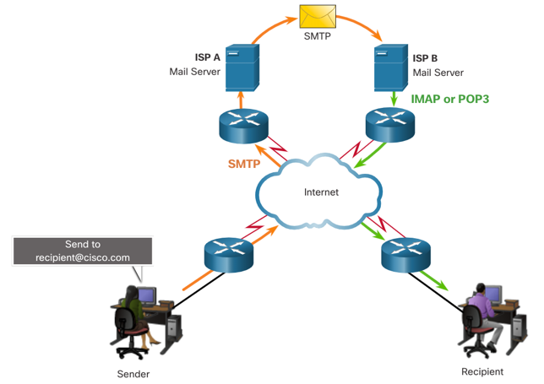
Email Protocols
Email is a store-and-forward method of sending, storing, and retrieving electronic messages across a network. Email messages are stored in databases on mail servers. Email clients communicate with mail servers to send and receive email.
The email protocols used for operation are:
Simple Mail Transfer Protocol (SMTP) – used to send mail.
Post Office Protocol (POP) & IMAP – used for clients to receive mail.
Notes:
15 – Application Layer
15.3 – Web and Email Protocols
15.3.3 – Email Protocols

Slide 73
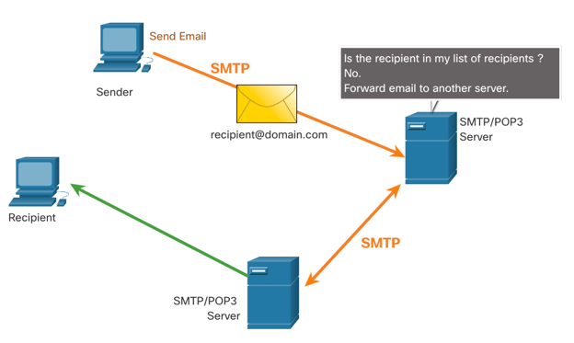
SMTP
When a client sends email, the client SMTP process connects with a server SMTP process on well-known port 25.
After the connection is made, the client attempts to send the email to the server across the connection.
When the server receives the message, it either places the message in a local account, if the recipient is local, or forwards the message to another mail server for delivery.
The destination email server may not be online or may be busy. If so, SMTP spools messages to be sent at a later time.
Note: SMTP message formats require a message header (recipient email address & sender email address) and a message body.
Notes:
15 – Application Layer
15.3 – Web and Email Protocols
15.3.4 – SMTP, POP and IMAP

Slide 74
Mail Routing
Sender uses UA to compose message and send
Sender’s UA sends message to her mail server; message placed in message queue
Client side of SMTP opens TCP connection with receiver’s mail server
SMTP client sends sender’s message over the TCP connection
Receiver’s mail server places the message in receiver’s mailbox
Receiver invokes his user agent to read message

Slide 75
SMTP
Simple Mail Transfer Protocol
A simple ASCHII protocol
After establishing a TCP connection to port 25, the sending machine(client) waits for the receiving machine(server)
The server starts by sending a line of text giving its identity and telling whether it is prepared to receive mail
If the server is not ready, the client releases the connection and tries again

Slide 76
SMTP
If the server is willing to accept e-mail, the client announces whom the e-mail is coming from and whom it is going to.
If such recipients exists at the destination, the server gives the client to go-ahead to send the message
Then the client sends the message and server acknowledges it.

Slide 77
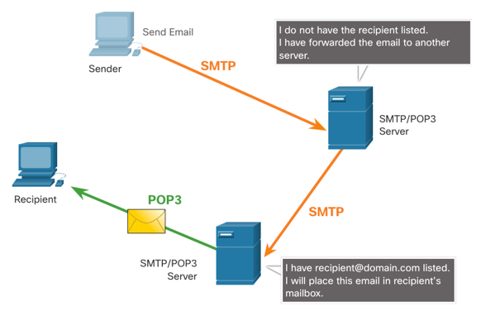
POP
POP is used by an application to retrieve mail from a mail server. When mail is downloaded from the server to the client using POP the messages are then deleted on the server.
The server starts the POP service by passively listening on TCP port 110 for client connection requests.
When a client wants to make use of the service, it sends a request to establish a TCP connection with the server.
When the connection is established, the POP server sends a greeting.
The client and POP server then exchange commands and responses until the connection is closed or aborted.
Note: Since POP does not store messages, it is not recommended for small businesses that need a centralized backup solution.
Notes:
15 – Application Layer
15.3 – Web and Email Protocols
15.3.4 – SMTP, POP and IMAP (Cont.)

Slide 78
POP3
Post Office 3 Protocol
Begins when the UA start their mail reader
The mail reader calls up the mail server and establishes a TCP connection with the mail transfer agent at port 110
Once the connection is established, POP3 goes through 3 states
Authorization Authorize the user
Transactions
Collect mail and mark them for deletion
Update
Causes mails to be deleted

Slide 79
IMAP
Internet Message Access Protocol
Assumes all e-mail will remain on the server indefinitely In multipart mailboxes
Provides mechanism for reading messages or even part of messages
Provides mechanism of creating, destroying and manipulating multiple mailboxes on the server

Slide 80
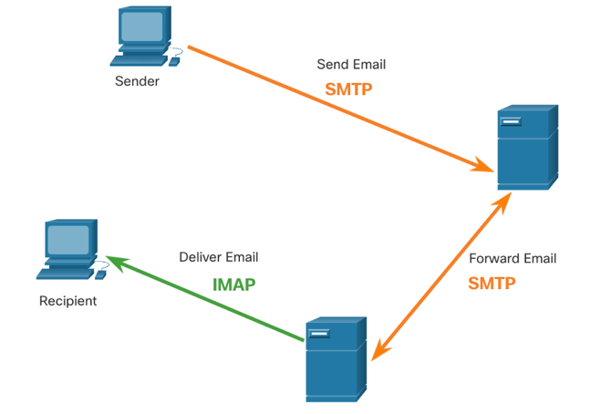
IMAP
IMAP is another protocol that describes a method to retrieve email messages.
Unlike POP, when a user connects to an IMAP server, copies of the messages are downloaded to the client application. The original messages are kept on the server until manually deleted.
When a user decides to delete a message, the server synchronizes that action and deletes the message from the server.
Notes:
15 – Application Layer
15.3 – Web and Email Protocols
15.3.4 – SMTP, POP and IMAP (Cont.)
15.3.5 – Check Your Understanding – Web and Email Protocols

Slide 81
MIME
Multipurpose Internet Mail Extensions
Supplementary protocol to allow non-ASCII data to be sent through e-mail
Different types of contents are supported by MIME

Slide 82
Type | Subtype | Description
Text | Plain | Unformatted
 | HTML | HTML format
Multipart | Mixed | Body contains ordered parts of different data types
 | Parallel | Same as above, but not ordered
Image | JPEG | Image in JPEG
 | GIF | Image in GIF
Video | MPEG | Video in MPEG
Audio | Basic | Single-channel encoding of voice at 8kHz
Application | Postscript | Adobe Postscript
 | Octet-stream | General binary data (8-bit bytes)

